Slide 1
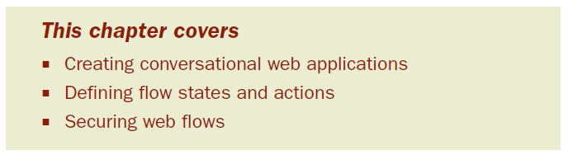
Chapter 8: Working with Spring Web Flow
There are times when a web application must take control of a web surfer’s voy- age, leading the user step by step through the application.
The quintessential exam- ple of such an application is the checkout process on an e-commerce site.
Notes:
Starting with the shopping cart, the application leads you through a process of entering shipping details, billing information, and ultimately an order confirmation.

Slide 2
Spring Web Flow is a web framework that enables development of elements fol- lowing a prescribed flow.
Spring Web Flow is an extension to Spring MVC that enables development of flow- based web applications.
It does this by separating the definition of an application’s flow from the classes and views that implement the flow’s behavior.
Web application for taking pizza orders.

Slide 3
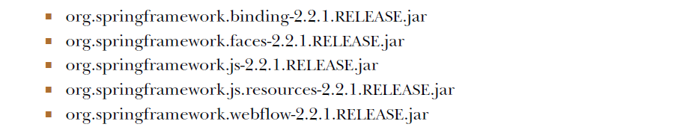
8.1 Installing Spring Web Flow

Slide 4
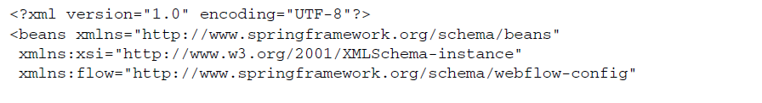
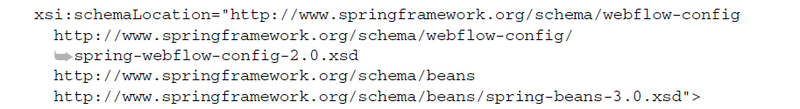
8.1.1 Configuring Web Flow in Spring
Spring Web Flow is built upon a foundation of Spring MVC.
All requests to a flow first go through Spring MVC’s DispatcherServlet.

Slide 5
WIRING A FLOW EXECUTOR
the flow executor drives the execution of a flow.
User enters a flow-> flow executor creates and launches an instance of the flow execution for that user-> flow pauses, -> flow executor resumes the flow once user has taken some action

Slide 6
Although the flow executor is responsible for creating and executing flows, it’s not responsible for loading flow definitions ->flow registry

Slide 7
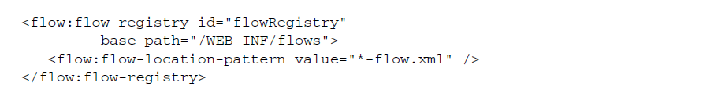
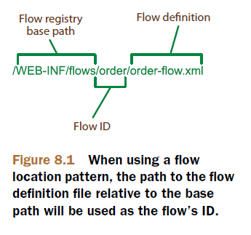
CONFIGURING A FLOW REGISTRY
A flow registry’s job is to load flow definitions and make them available to the flow executor.

Slide 8
All flows are referred to by their IDs. Using the <flow:flow-location-pattern> as we have, the flow ID will be the directory path relative to the base-path—or the part of the path represented with the double asterisk.
Alternatively, you could leave the base-path attribute off and explicitly identify the flow definition file’s location
Notes:
-When configured this way, the flow’s ID is derived from the base name of the flow definition file; springpizza in this case

Slide 9
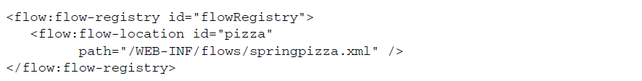
explicit ID

Slide 10

HANDLING FLOW REQUESTS
As we saw in the previous chapter, DispatcherServlet typically dispatches requests to controllers.
For flows, we’ll need a FlowHandlerMapping to help DispatcherServlet know that it should send flow requests to Spring Web Flow.

Slide 11
the FlowHandlerMapping is wired with a reference to the flow registry so it knows when a request’s URL maps to a flow.
For example, if we have a flow whose ID is pizza, then FlowHandlerMapping will know to map a request to that flow if the request’s URL pattern (relative to the application context path) is /pizza.
Whereas the FlowHandlerMapping’s job is to direct flow requests to Spring Web Flow, it’s the job of a FlowHandlerAdapter to answer that call.

Slide 12
A FlowHandlerAdapter is equivalent to a Spring MVC controller in that it handles requests coming in for a flow and processes those requests.
This handler adapter is the bridge between DispatcherServlet and Spring Web Flow.

Slide 13
Exercise 8-1
Configure all the beans and components needed for Spring Web Flow to work
flow.xml

Slide 14
8.2 The components of a flow
In Spring Web Flow, a flow is defined by three primary elements
states are points in a flow where something happens. Think of road trips (towns, truck stops, scenic stops)
some logic is performed, some decision is made, or some page is presented to the user
transitions are the roads that connect those points
as a flow progresses, it collects some data: the current condition of the flow -

Slide 15
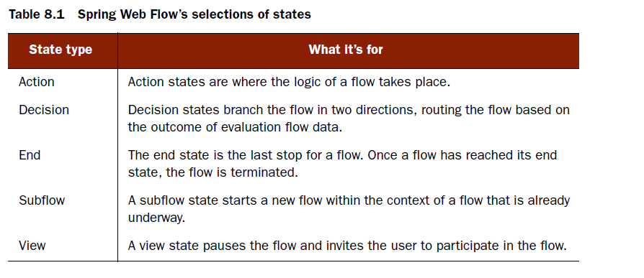
8.2.1 States
The selection of states provided by Spring Web Flow makes it possible to construct virtually any arrangement of functionality into a conversational web application

Slide 16
VIEW STATES
View states are used to display information to the user and to offer the user an opportunity to play an active role in the flow.
Within the flow definition XML file, the <view-state> element is used to define a view state:
the id attribute serves a dual purpose. It identifies the state within the flow, it specifies welcome as the logical name of the view to be rendered when the flow reaches this state.

Slide 17
If a flow presents a form to the user, you may want to specify the object to which the form will be bound. To do that, set the model attribute:
Here we’ve specified that the form in the takePayment view will be bound to the flow- scoped paymentDetails object.

Slide 18
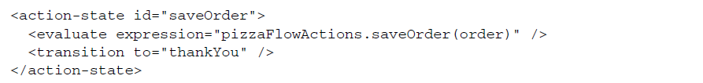
ACTION STATES
Whereas view states involve the users of the application in the flow, action states are where the application itself goes to work.
Although it’s not strictly required, <action-state> elements usually have an <evaluate> element as a child.

Slide 19
In this case, expression is given a SpEL2 expression which indicates that the saveOrder() method should be called on a bean whose ID is pizzaFlowActions

Slide 20
DECISION STATES
It’s possible for a flow to be purely linear, stepping from one state to another without taking any alternate routes.
But more often a flow branches at one point or another, depending on the flow’s current circumstances.
A decision state will evaluate a Boolean expression and will take one of two transitions, depending on whether the expression evaluates to true or false.

Slide 21
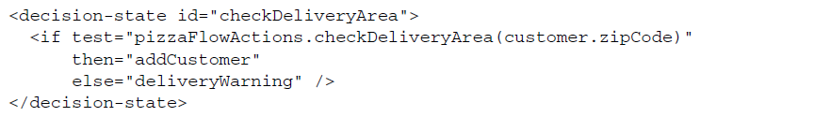
The <if> ele-ment is the heart of a decision state. It’s where the expression is evaluated.

Slide 22
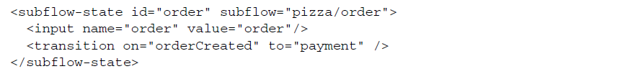
SUBFLOW STATES
it’s a good idea to break flows down into discrete parts.
The <subflow-state> element lets you call another flow from within an executing flow.

Slide 23
Here, the <input> element is used to pass the order object as input to the subflow. And, if the subflow ends with an <end-state> whose ID is orderCreated, then the flow will transition to the state whose ID is payment.

Slide 24
END STATES
The <end-state> element designates the end of a flow
When the flow reaches an <end-state>, the flow ends. What happens next depends on a few factors:

Slide 25
If the flow that’s ending is a subflow, then the calling flow will proceed from the <subflow-state>. The <end-state>’s ID will be used as an event to trigger the transition away from the <subflow-state>.
If the <end-state> has its view attribute set, the specified view will be rendered. The view may be a flow-relative path to a view template, prefixed with externalRedirect: to redirect to some page external to the flow, or prefixed with flowRedirect: to redirect to another flow.
If the ending flow isn’t a subflow and no view is specified, then the flow simply ends. The browser ends up landing on the flow’s base URL, and with no current flow active, a new instance of the flow begins.

Slide 26
8.2.2 Transitions
transitions connect the states within a flow
A state may have multiple transitions, each one representing a different path that could be taken upon completion of the state.
A transition is defined by the <transition> element, a child of the various state elements (<action-state>, <view-state>, and <subflow-state>). In its simplest form, the <transition> element identifies the next state in the flow:

Slide 27

The to attribute is used to specify the next state in the flow.
When <transition> is declared with only a to attribute, the transition is the default transition for that state and will be taken if no other transitions are applicable.

Slide 28

GLOBAL TRANSITIONS

Slide 29
8.2.3 Flow data
As the flow progresses from one state to another, it picks up some data.
Sometimes that data is only needed for a little while
Other times, that data is carried around through the entire flow and is ultimately used as the flow completes

Slide 30
DECLARING VARIABLES
Flow data is stored away in variables that can be referenced at various points in the flow.
This variable will be available to all states in a flow.
Notes:
The <set> element works much the same as the <evaluate> element, setting a vari-
able to the resulting value from an evaluated expression.

Slide 31
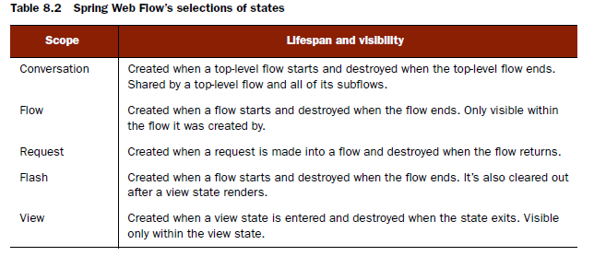
SCOPING FLOW DATA
When declaring a variable using the <var> element, the variable is always flow-scoped within the flow defining the variable.

Slide 32
When using <set> or <evaluate>, the scope is specified as a prefix for the name or result attribute

Slide 33
8.3 Putting it all together: the pizza flow
As it turns out, the process of ordering a pizza can be defined nicely in a flow.
We’ll start by building a high-level flow that defines the overall process of ordering a pizza.
Then we’ll break that flow down into subflows that define the details at a lower level.

Slide 34
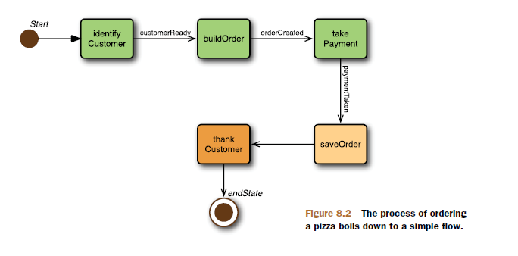
8.3.1Defining the base flow
Notes:
-The boxes in the diagram represent states and the arrows represent transitions.

Slide 35
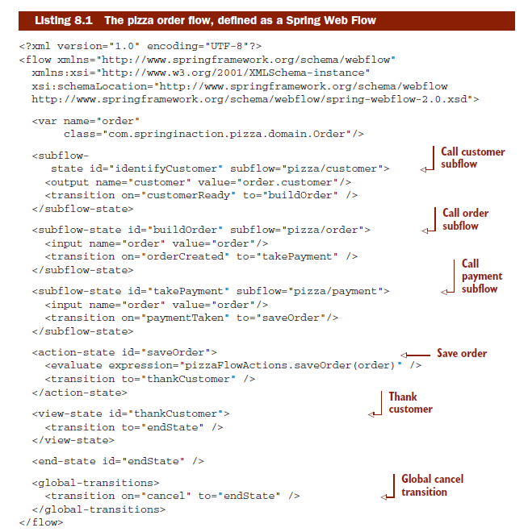

Slide 36
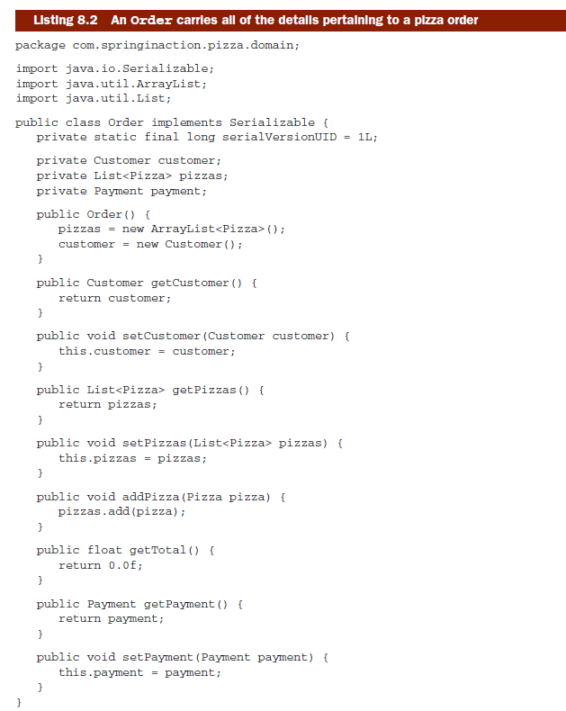

Slide 37
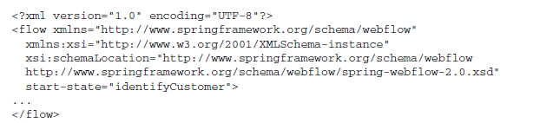
By default, the first state in the flow definition file is also the first state that will be visited in the flow.
But if you’d like, you can explicitly identify any state as the starting state by setting the start-state attribute in the <flow> element

Slide 38
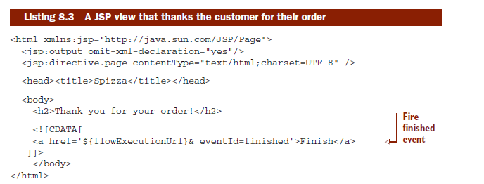
The order flow variable will be populated by the first three states and then saved in the fourth state.
Notes:
-The identifyCustomer subflow state uses the <output> element to populate the order’s customer property, setting it to the output received from calling the customer subflow.
-The buildOrder and takePayment states take a different approach, using <input> to pass the order flow variable as input so that those sub- flows can populate the order internally.
-The saveOrder state is an action state that handles that task. It uses
<evaluate> to make a call to the saveOrder() method on the bean whose ID is
pizzaFlowActions, passing in the order to be saved.

Slide 39
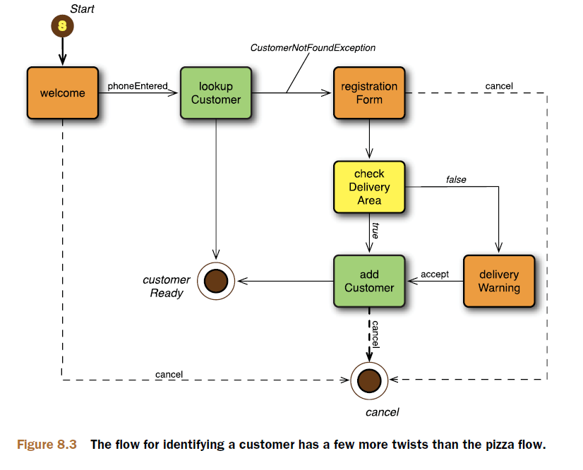
8.3.2 Collecting customer information

Slide 40
-End of Chapter 8-

